Slide 1
VIRTUAL HEALTH ASSISTANT
DEVELOPED BY PYTHON SUMMONERS

Slide 2
MAIN FEATURES OF VIRTUAL HEALTH ASSISTANT
Presents a menu driven interface for both patient and admin users.
Admin interface is password protected.
Allows the patient to view his or her patient data.
Allows the admin to add new records, update data, view all data and also search a patient’s data using the patient no.
Allows the user to make an appointment with a doctor of a particular department according to the symptoms submitted

Slide 3
MORE ABOUT VIRTUAL HEALTH ASSISTANT
Our idea is to create a program which mainly consists of two parts, a personal patient assistant and a patient database controlled by the hospital staff. The admin interface is password protected.
Personal patient assistant suggests patients to visit a doctor of a particular department when the symptoms are given. It also helps them to make an appointment with the doctor.
The patient database can be accessed by the hospital staff and doctors using a patient ID which shows the previous health records of the patient and other important informations.They can also update the old patient data and even create new patient record.

Slide 4
PROGRAM LAYOUT
MAIN MENU
PATIENT
1.Display
2.Appointment
HOSPITAL
STAFF
1.Insert
2.Display
3.Edit
4.Search
EXIT

Slide 5
PROGRAMMING LANGUAGE USED
C++

Slide 6
HEADER FILES USED
iostream.h
conio.h
stdio.h
fstream.h
process.h
string.h
stdlib.h
iomanip.h
dos.h

Slide 7
MEMBER FUNCTIONS USED
returnpno
add
put
( Class - Hstaff )

Slide 8
NON MEMBER FUNCTIONS
insert ()
edit ()
display ()
Search ()
admin ()
patient()
main ()
(Class - Hstaff )

Slide 9
DATA MEMBERS
Integers
age
pno
phone no
String
pbgroup
symptoms
phone no
pname
(class - Hstaff )

Slide 10
OUTPUT

Slide 11


Slide 12

MAIN MENU

Slide 13

ADMIN MENU

Slide 14
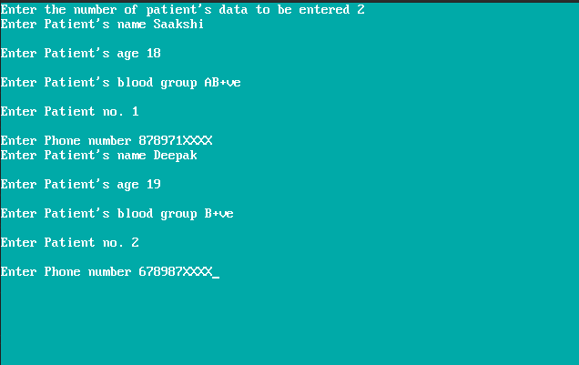
ADDING 2 NEW PATIENT’S DETAILS

Slide 15
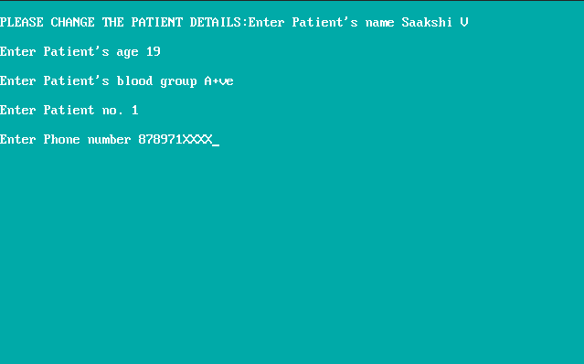
EDITING 1ST PATIENT’S DETAILS

Slide 16


Slide 17

VIEWING ALL PATIENT’S DATA

Slide 18
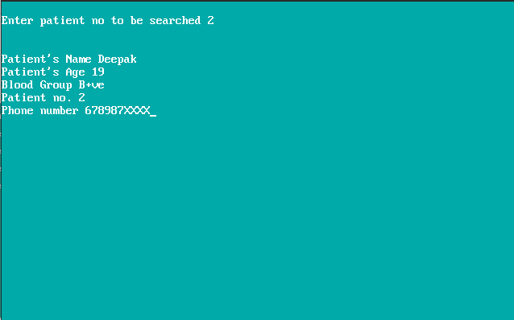
SEARCHING A PATIENT’S DATA

Slide 19
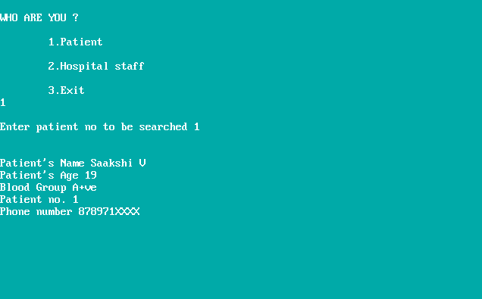
PATIENT MENU

Slide 20
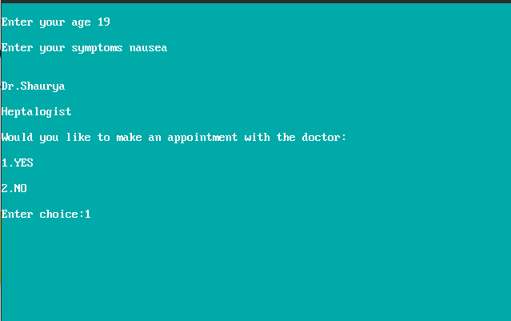
PATIENT MAKING AN APPOINTMENT

Slide 21
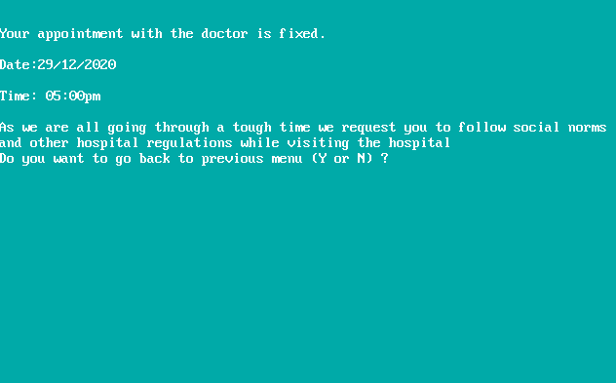

Slide 22
SUGGESTED INPUT FOR SYMPTOMS
Fever
Cough
Redness
Chills
Fatigue
Extreme hunger
Increased thirst
Chest pain
Sudden weakness
Nausea
Bruising

Slide 23
GROUP MEMBERS
Jithin Jagadeesh
Parvathi Girish
Pooja Johnson
Govind Harikumar Nair

Slide 24


